Slide 1
Using Technology to Engage Parents
Richard Byrne
Free Technology for Teachers

Slide 2

Give Me a Reason to Like You

Slide 3
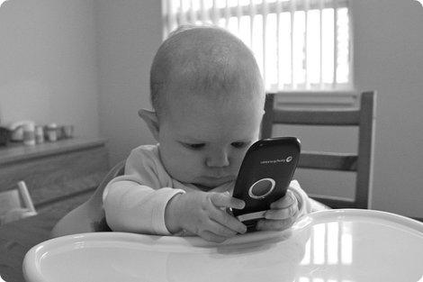
Meet Me Where I Am
cc licensed ( BY SA ) flickr photo by SparkCBC: http://flickr.com/photos/25031050@N06/4442939883/

Slide 4



Slide 5


Give Me The Data

Slide 6
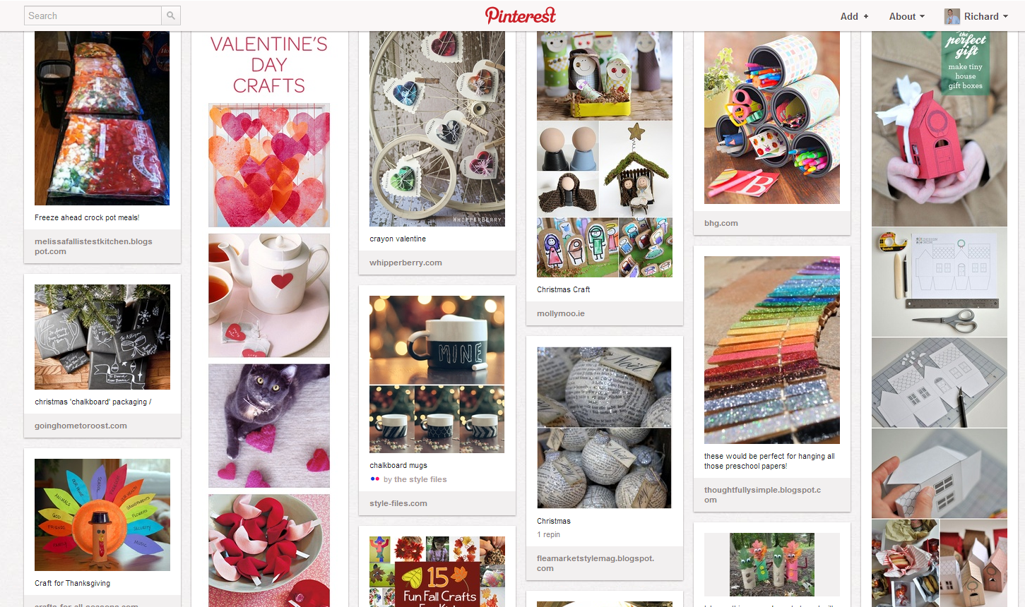
Bond With Me

